Slide 1

Classification Machine learning Intro Summer Camp 2020
Can Yang

Slide 2

About Me
Pronunciation of my name: Tzan
Bachelor degree in Automation.
Master degree in Embedded and Intelligent System.
Worked at Smart eye – eye tracking techniques
Worked at CEVT as a software developer
Working at Volvo cars as a software developer

Slide 3
Agenda
Recap of machine learning
What is classification
KNN algorithm
Project

Slide 4
We will talk about…
Machine Learning
Simple review about Machine learning
Categories of Machine learning
Supervised learning
What is Classification
KNN Algorithm
Apply KNN in Iris dataset
Supervised Learning
Classification
KNN

Slide 5

A quick review
Statistical learning: AI? Machine learning?
AI- Mimicking human abilities
Machine learning - Trains a machine how to learn
Different categories of Machine Learning:
(Task-based categories)
● Supervised Learning
● Unsupervised Learning
● Reinforcement Learning
Notes:
Statistical learning refers to a set of tools for modeling and understanding complex datasets.
statistical learning has become a very hot field in many scientific areas as well as marketing, finance, and other business disciplines
It’s tough to make predictions, especially about the future.
The field encompasses many methods such
Machine learning tasks are classified into several broad categories.
Supervise learning is the process of learning with training labels. And this will be focued on today
For each observation of the predictor measurement(s) xi, i = 1,...,n there is an associated response measurement yi. We wish to fit a model that relates the response to the predictors, with the aim of accurately predicting the response for future observations (prediction) or better understanding the relationship between the response and the predictors (inference).
Unsupervise learning uses machine learning algothms that draw conclusion on unlanbeled data:
In contrast, unsupervised learning describes the somewhat more challenging situation in which for every observation i = 1,...,n, we observe a vector of measurements xi but no associated response yi. It is not possible to fit a linear regression model, since there is no response variable to predict.
Reinforcement Learning is taking suitable action to maximize reward in a particular situation.

Slide 6

Classification

Slide 7
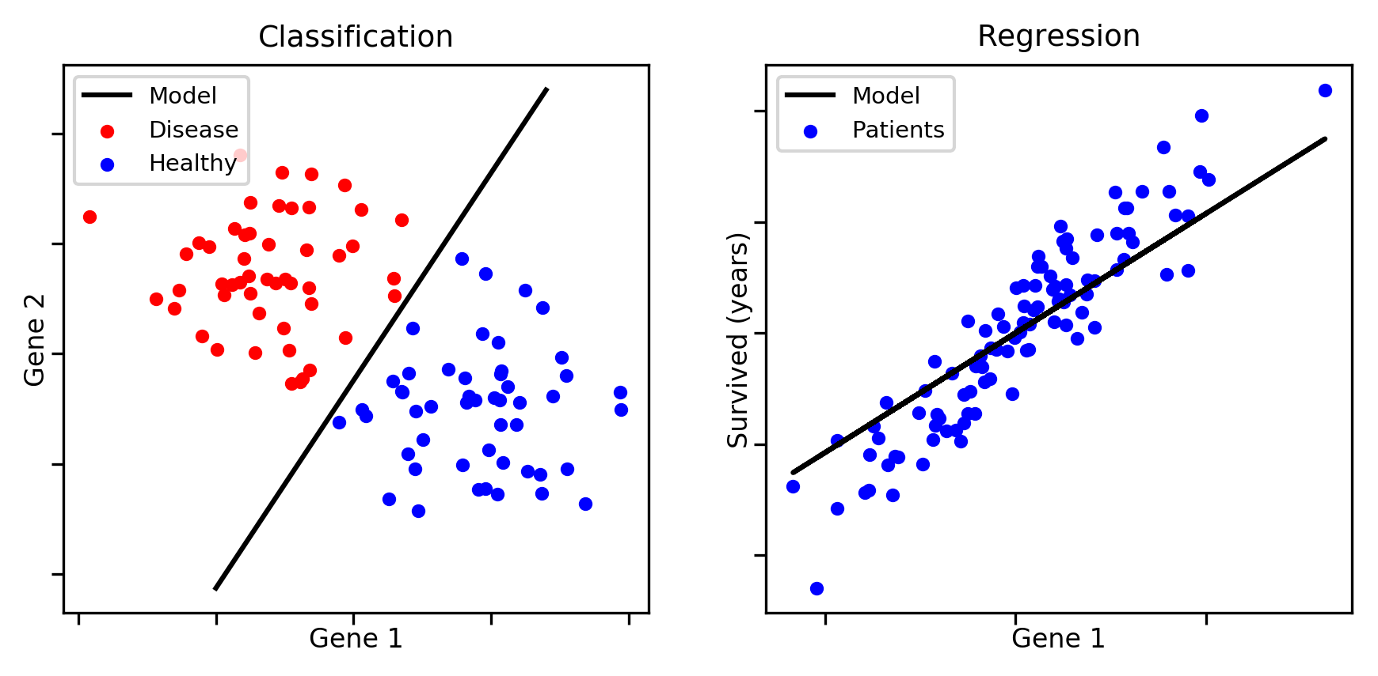
Supervised Learning
Typical tasks:
● Classification:
○ Assign datapoint to one of the available classes
○ Discrete output/label
● Regression:
We will talk about it tomorrow
Notes:
Variables can be characterized as either quantitative or qualitative (also quantitative qualitative known as categorical)
Classification is taking inout or data point and mapping into discrete classes. Like True or false
qualitative variables take on values in one of K different classes, or categories.
Examples of qualitative class variables include a person’s gender (male or female), the brand of product purchased (brand A, B, or C), whether a person defaults on a debt (yes or no), or a cancer diagnosis (Acute Myelogenous Leukemia, Acute Lymphoblastic Leukemia, or No Leukemia).
Regression, contin value function. Mapping to real value or number,
Quantitative variables take on numerical values.
Examples include a person’s age, height, or income, the value of a house, categorical and the price of a stock.

Slide 8
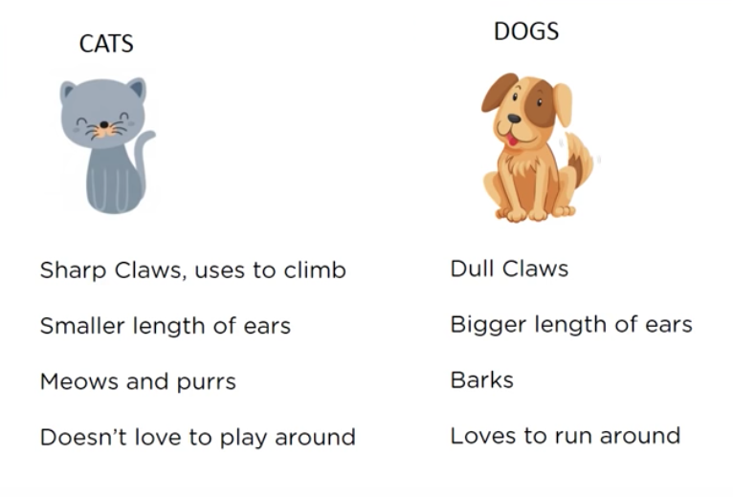
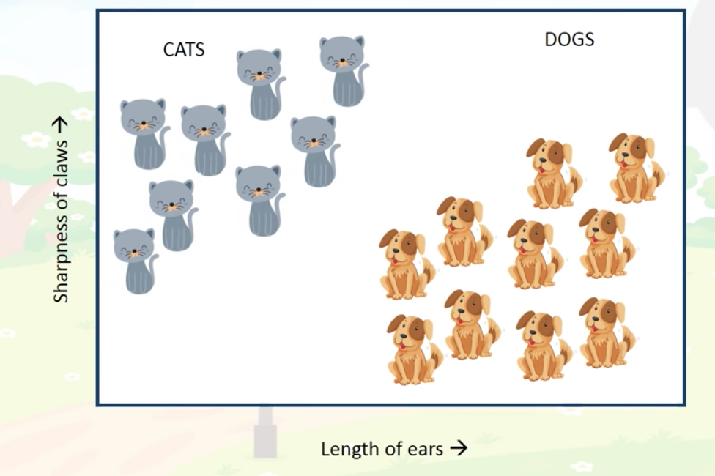
Supervised Learning
Examples:
● Classification:
● Regression

Slide 9
Classifiaction
Predict a discrete value(label) associated with a feature vector
Notes:
It doesn’t have to be binary, but a Finite number of labels

Slide 10
Nearest Neighbor

Slide 11
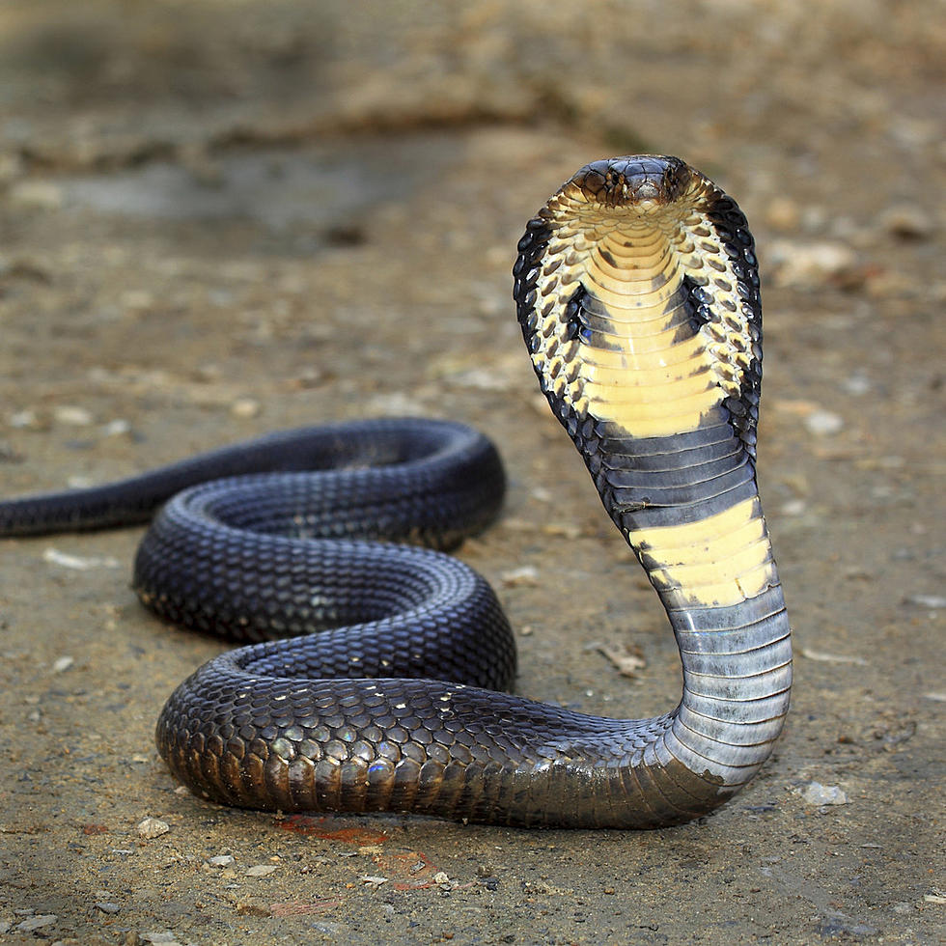
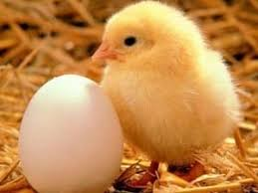
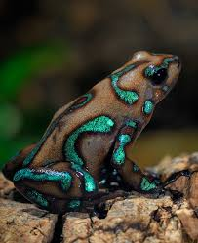
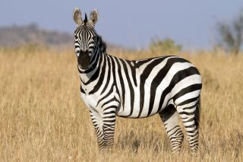
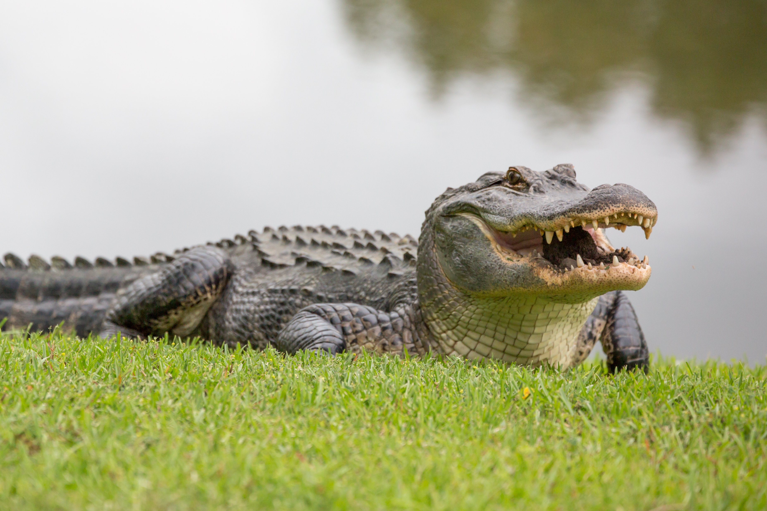
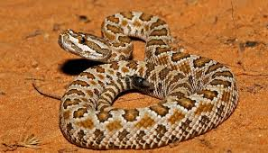
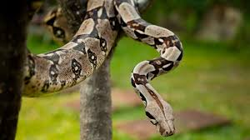
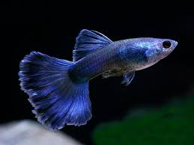
Nearest Neighbor – Distance Matrix
 | Cobra (Reptile) | Rattlesnake (Reptile) | Boa constrictor (Reptile) | Chicken (~ Reptile) | Guppy (~ Reptile) | Dart frog (~ Reptile) | Prediction | Prediction result
Zebra | 2.236 | 2.236 | 1.732 | 2.0 | 1.414 | 1.414
Alligator | 1.414 | 1.414 | 1.414 | 1.0 | 1.732 | 1.732
Chicken
Dart frog
Cobra
Zebra
Alligator
Rattlesnake
Boa constrictor
Guppy
Notes:
Find the nearesr example in the training daya
Predict the label associated with that example

Slide 12
Nearest Neighbor – Distance Matrix
 | Cobra (Reptile) | Rattlesnake (Reptile) | Boa constrictor (Reptile) | Chicken (~ Reptile) | Guppy (~ Reptile) | Dart frog (~ Reptile) | Prediction | Prediction result
Zebra | 2.236 | 2.236 | 1.732 | 2.0 | 1.414 | 1.414
Alligator | 1.414 | 1.414 | 1.414 | 1.0 | 1.732 | 1.732
~ Reptile
Correct
Reptile
Wrong
Chicken
Dart frog
Cobra
Zebra
Alligator
Rattlesnake
Boa constrictor
Guppy
Notes:
Find the nearesr example in the training daya
Predict the label associated with that example

Slide 13
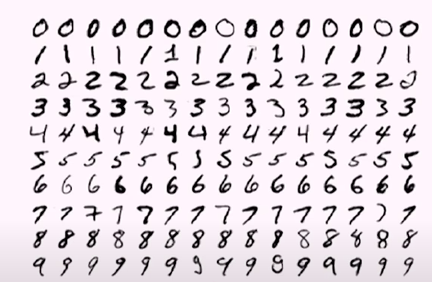
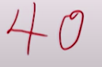
Nearest Neighbor – Distance Matrix
40

Slide 14
K-nearest neighbors
KNN
Notes:
If you have a imbalance data, you need to be very careful with the k

Slide 15
K-Nearest Neighbor – Distance Matrix
k = 3
40

Slide 16
K-Nearest Neighbor – Distance Matrix
k = 3
 | Cobra (Reptile) | Rattlesnake (Reptile) | Boa constrictor (Reptile) | Chicken (~ Reptile) | Guppy (~ Reptile) | Dart frog (~ Reptile) | Prediction | Prediction result
Zebra | 2.236 | 2.236 | 1.732 | 2.0 | 1.414 | 1.414 | ~ Reptile | Correct
Alligator | 1.414 | 1.414 | 1.414 | 1.0 | 1.732 | 1.732 | Reptile | Correct
Chicken
Dart frog
Cobra
Zebra
Alligator
Rattlesnake
Boa constrictor
Guppy
Notes:
Find the nearesr example in the training daya
Predict the label associated with that example

Slide 17
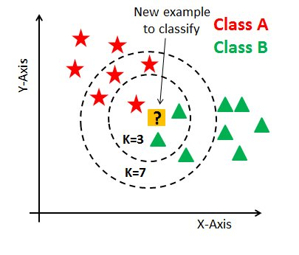
K-Nearest Neighbor
It classifies a data point based on how its neighbors are classified
Step 1: Find the value for K
k is a user-defined constant
Binary classification: k- odd number
A popular way: Square root of total number of data points
Notes:
Given a positive in- K-nearest teger K and a test observation x0, the KNN classifier first identifies the neighbors K points in the training data that are closest to x0, represented by N0. It then estimates the conditional probability for class j as the fraction of points in N0 whose response values equal j
k-Nearest Neighbor(k-NN) is an instance-based supervised learning algorithm which classifies a new instance by comparing it with already stored instances in the memory that have already been seen in training.

Slide 18
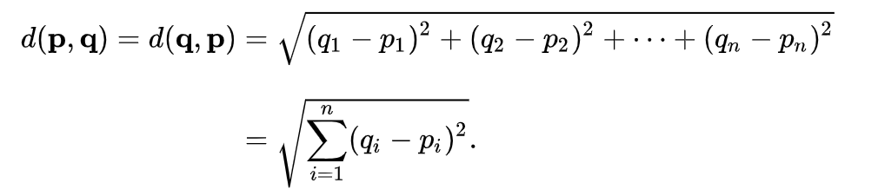
K-Nearest Neighbor
Step 1: Find the value for K
Step 2: Calculate the distances (Euclidean) between the new input (test data) and all the training data.
Python:
dist = euclideanDistance(testInstance, trainingSet[x], length)
Notes:
A simple supervised algorithem. It classfies a data point based on how its nerbough are classfied
Low k more noisy. Too big k
Square root of all the number
The most commonly used metrics for calculating distance are Euclidean, Manhattan and Minkowski

Slide 19
K-Nearest Neighbor
Step 1: Find the value for K
Step 2: Calculate the distances
Step 3: Sort the distance and determine k nearest neighbors based on minimum distance values
Python:
distances.sort()
Notes:
A simple supervised algorithem. It classfies a data point based on how its nerbough are classfied
Low k more noisy. Too big k
Square root of all the number
The most commonly used metrics for calculating distance are Euclidean, Manhattan and Minkowski

Slide 20
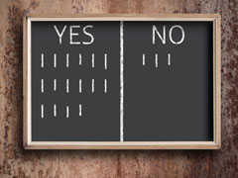
K-Nearest Neighbor
Step 1: Find the value for K
Step 2: Calculate the distances
Step 3: Sort the distance and find closet neighbors
Step 4: Analyze the category of those neighbors.
Assign the category for the test data based on majority vote
Notes:
A simple supervised algorithem. It classfies a data point based on how its nerbough are classfied
Low k more noisy. Too big k
Square root of all the number
The most commonly used metrics for calculating distance are Euclidean, Manhattan and Minkowski

Slide 21
K-Nearest Neighbor
Step 1: Find the value for K
Step 2: Calculate the distances
Step 3: Sort the distance and find closet neighbors
Step 4: Assign the category for the test data
Step 5: Return the predicted class
Notes:
A simple supervised algorithem. It classfies a data point based on how its nerbough are classfied
Low k more noisy. Too big k
Square root of all the number
The most commonly used metrics for calculating distance are Euclidean, Manhattan and Minkowski

Slide 22

Project Time
Notes:
If you have a imbalance data, you need to be very careful with the k

Slide 23
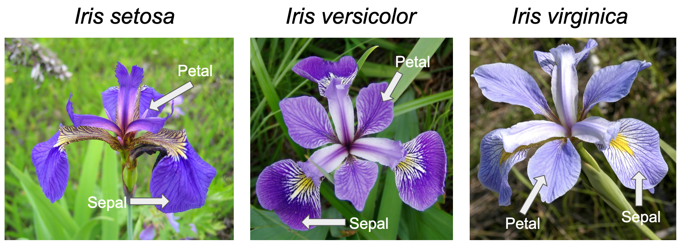
Review the dataset - Iris
Data Set Characteristics: | Multivariate | Number of Instances: | 150 | Area: | Life
Attribute Characteristics: | Real | Number of Attributes: | 4 | Date Donated | 1988-07-01
Associated Tasks: | Classification | Missing Values? | No | Number of Web Hits: | 3402535
http://archive.ics.uci.edu/ml/datasets/Iris
Notes:
This is perhaps the best known database to be found in the pattern recognition literature. Fisher's paper is a classic in the field and is referenced frequently to this day. (See Duda & Hart, for example.) The data set contains 3 classes of 50 instances each, where each class refers to a type of iris plant. One class is linearly separable from the other 2; the latter are NOT linearly separable from each other.

Slide 24
Useful link:
Python
Google's Python class: https://developers.google.com/edu/python
Iris Dataset: http://archive.ics.uci.edu/ml/datasets/Iris
KNN
https://towardsdatascience.com/k-nn-on-iris-dataset-3b827f2591e

